Slide 1
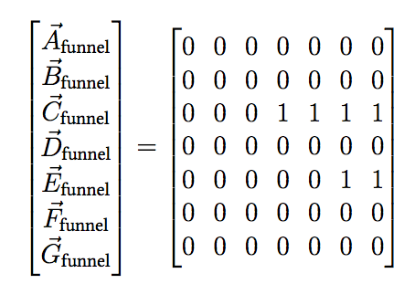
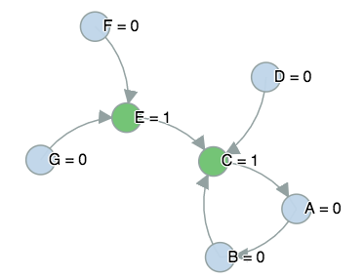
Traversal Funnels Matrix
Funnels Path starting at article G

